Slide 1
Chapter 1:
Adaptability—The Key to Mobile Computing

Slide 2
Adapting the data rate on move using wifi
Transparency: is the ability of a system to hide some characteristics of its underlying implementation from users.
Access transparency: is the ability of a system to hide the differences in data representation on various machines and the mode of access of a particular resource.
Location transparency: is the ability of a system to conceal the location of a resource.
Related to location transparency are name transparency: (which ensures that the name of a resource does not reveal any hints as to the physical location of the resource) and user mobility (which ensures that no matter which machine a user is logged onto, one should be able to access resources with the same name).
Failure transparency: is the ability of the system to hide failure and recovery of a system component.

Slide 3
Adaptability—The Key to Mobile Computing
Constraints of mobile computing environments:
Mobile computers can be expected to be more resource-poor than their static counterparts.
mobile computers require a source of electrical energy.
Mobile computers are less secure and reliable.
Mobile connectivity can be highly variable in terms of it’s performance.

Slide 4
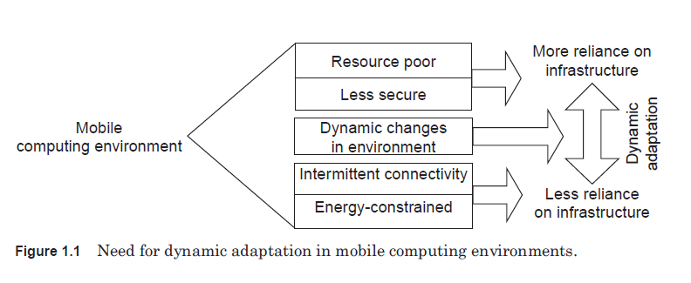
Adaptability—The Key to Mobile Computing

Slide 5
Adaptability—The Key to Mobile Computing
Application-aware adaptation:
Who should be responsible for adaptation—the application, the system, or both?
application-transparent (the system is fully responsible for adaptation)
laissez-faire (the system provides no support at all) – not desirable.
Further, no support from the underlying system restricts the types of adaptations that can be performed - Multimedia applications.
In one you are videoconferencing using a mobile device, and in the other you are watching a live video stream from a remote server on your mobile device.
In one, you move from an area with sufficient bandwidth for your application to an area where the amount of bandwidth is less than that needed by your application.
In the other, your laptop’s battery power level drops considerably. Both scenarios deal with changes in availability of resources.
Application aware approach

Slide 6
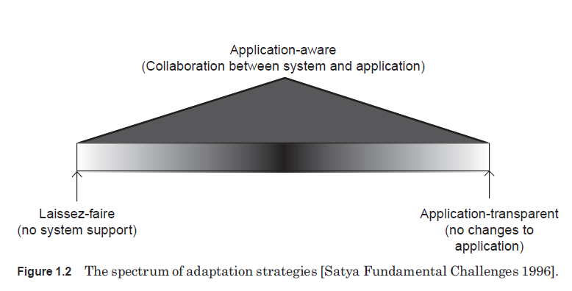
Adaptation

Slide 7
Adaptation
1.3 Mechanism for Adaptaion – What can be adapted ? ,How can be adapted ?
Adapting functionality:
The first approach is EXTENDED CS model instead of standard CS model.
In client-Server model a client, or the underlying system—middleware—may select dynamically the server from which to request the service.
A server may or may not maintain information, or state, about the clients to which it is providing service.
The state information may be maintained as soft or hard.
Soft state information, once installed, has to be updated periodically to avoid automatic deletion by the state maintainer (in our case, a server), whereas hard state information, once installed, requires explicit deletion.
Soft state is useful in systems with very dynamic configurations, such as mobile systems.
Soft state is used in various protocols, such as the Resource Reservation Protocol (RSVP) and the Internet Group Management Protocol (IGMP) to adapt gracefully to dynamic changes in the system state.

Slide 8
Adaptation
CS model has the following characteristics:
A few trusted servers act as the permanent safe haven of the data.
A large number of un-trusted clients can efficiently and securely access the data.
Good performance is achieved by using techniques such as caching and prefetching.
Security of data is ensured by employing end-to-end authentication and encrypted transmission.

Slide 9
Adaptation
Impact of mobility on the CS model:
The CS model permits a resource-poor mobile client (THIN CLIENTS) to request a resource-rich server to perform expensive computations on its behalf.
For example, the client can send a request to the server, go to sleep to conserve energy, and later wake up to obtain the result from the server.
For the sake of improved performance and availability, the boundary between the clients and servers may have to be adjusted dynamically.
In order to cope with the resource limitations of clients, certain operations that normally are performed at the client may have to be performed by resource rich servers.

Slide 10
Adaptation
Adapting data:
Adaptation to resource availability is by varying the quality of data (fidelity).
This kind of adaptation is extremely useful in mobile information access applications.
The QoS requirements for such applications are:
Information quality: “Ideally, a data item being accessed on a mobile client should be indistinguishable from that available to the application if it were to execute on the server storing the data.”
Performance
From the mobile client’s perspective. Latency of data access should be within tolerable limits.
From the system’s perspective. Throughput of the system should be maximized.
It’s difficult to have highest performance and highest quality – video downloading

Slide 11
Adaptation
Fidelity and agility:
Data fidelity has many dimensions depending on its type. Consistency is a dimension which is shared by all data types. The other dimensions are type-dependent :
Video data—frame rate and image quality
Spatial data such as topographic maps—minimum feature size
Telemetry data—sampling rate and timeliness
Agility is defined as the speed and accuracy with which an adaptive application detects and responds to changes in its computing environment, e.g., change in resource availability.
The larger the change, the more important agility is. For example, an adaptive system that tries to adapt to the availability of connection bandwidth can try to determine how well the system reacts to sudden changes in bandwidth.

Slide 12
Adaptation
How to Develop or Incorporate Adaptations in Applications?
It is difficult to enumerate all the mechanisms that can be employed to construct adaptive programs.
However, it should be clear intuitively that all adaptive programs must adapt to some detectable change in their environment.
Either a program can implement its own mechanisms to detect the changes, or mechanisms may be provided by some other entity—a middleware layer or operating system—to make the program aware of these external changes. –
Example : TCP
In the state-based approach, changes in mobile computing are viewed as state transitions.

Slide 13
Adaptation
Consider the functionality adaptation in the Coda (Continued data availability) distributed file system developed at Carnegie Mellon University.
Venus adapts its functionality based on the state of the connectivity between the client and the server. Venus uses the following four states:
Hoarding: Venus is in the hoarding state when it has strong connectivity with the server. In this state, the client aggressively prefetches files from the server to store locally. Files to be prefetched are decided on the basis of user preference and access pattern.
Emulating: Venus is in the emulating state when it is disconnected from the server. In this state, the client emulates the server by optimistically allowing both read and write access to local files. To later update the primary copy of the files on the server and to detect any conflicting updates, the client maintains a log of all file operations.
Write-disconnected: Venus is in the write-disconnected state when the client has weak connectivity to the server. In this state, a Coda client decides whether to fetch files from the server or to allow local access.
Reintegration. Venus enters this state when the connectivity improves to strong connectivity. In this state, Venus resynchronizes its cache with the accessible servers. The log of operations is used for this purpose. If any conflict is detected, then user assistance may be required. On completion of resynchronization, Venus enters the hoarding state.

Slide 14
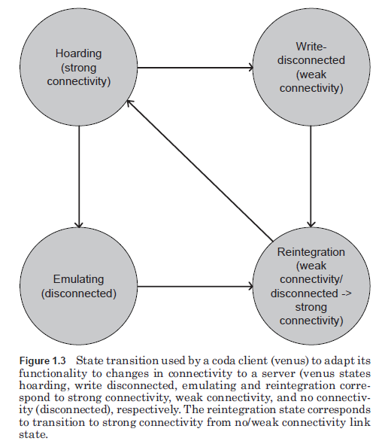
Adaptation

Slide 15
Adaptation
Where can adaptations be performed?
In a distributed application, in particular, a CS application, the adaptation can be performed at the client, at the server, or at both the client and the server.
Several different adaptations may be performed on different components located at different points in the data and control path between the client and the server:
Adapting to the hardware/software capabilities of the mobile device—in the proxy and/or at the server
Adapting to the connectivity of the mobile device—at the server and/or the client
Adapting to the resource availability at the mobile device—at the client

Slide 16
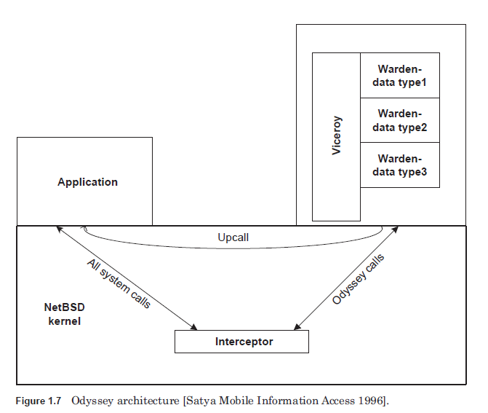
Adaptation
Recap: Applications are in a better position to perform application specific adaptations.
Support for Building Adaptive Mobile Applications
Odyssey (a middleware for application aware adaptation developed at CMU):
Odyssey aims to provide high fidelity and to support concurrent mobile applications with agility.
- Provides collaboration

Slide 17
Adaptation
Rover: Rover is an object-based software toolkit for developing both mobility aware
and mobility-transparent CS distributed applications.
It provides application developers with two programming and communication abstractions specifically designed for assisting applications in harsh network environments such as mobile computing—relocatable dynamic objects (RDOs) and queued remote procedure calls (QRPCs).
RDOs can be used to reduce interaction between two weakly connected entities, such as a client on the mobile device and a server in the wireline network.
Rover RDOs are objects with well defined interfaces and are loadable dynamically from the server to the client.
This, in essence, moves objects to the client machine, avoiding the client having to communicate with the object at the server.
QRPCs can be used to handle disconnections. Rover QRPCs are essentially nonblocking remote procedure calls (RPCs) that support split-phase operations.

Slide 18
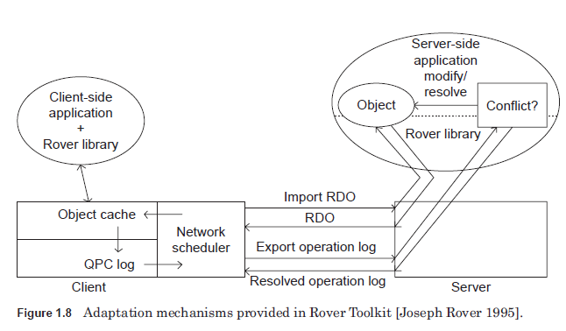
Adaptation

Slide 19
Adaptation
Rover Make use of asymmetric links. The queued RPC requests are not associated with a particular network interface. Thus responses can be obtained over any network device. This permits, for example, an application to launch requests over expensive links and to receive responses over cheaper links. This is beneficial for situations where the request size is much smaller than the expected response size.
Stage messages near their destination. RPC queuing can be arranged to occur just before a “bad” link. If the link quality improves, the RPC queue will then be cleared out. \

